Slide 1
CLINICAL FEATURES OF GINGIVITIS
RUNGTA COLLEGE OF DENTAL SCIENCES AND RESEARCH,BHILAI
Dr pushpendra yadav
Senior Lecturer
Dept of Periodontology

Slide 2
SPECIFIC LEARNING OBJECTIVES
Core areas | Domain | Category
Introduction | Affective | Desire to know
Classification | Cognitive | Must to know
Gingivitis | Cognitive | Must to know
Gingival Bleeding on Probing | Cognitive | Must to know
Course and Duration | Cognitive | Must to know
Clinical Findings | Cognitive | Must to know

Slide 3
content
PART I
Introduction
Classification
Gingivitis
Gingival Bleeding on Probing
PARTII
Course and Duration
Clinical Findings
Summary
Reference

Slide 4
introduction
Experimental gingivitis studies provided the first empiric evidence that the accumulation of microbial biofilm on clean tooth surfaces results in the development of an inflammatory process around gingival tissue.
Recent experimental gingivitis studies suggest an important role of the host response in the development and degree of gingival inflammation.

Slide 6
CLASSIFICATION
Course & Duration
Acute
Involvement of teeth
Localised
Generalised
Location
Marginal
Papillary
Recurrent
Diffuse
Chronic

Slide 7
Gingivitis
with sudden onset
short duration and
can be painful.
A less severe phase of this condition can also occur.

Slide 8
Recurrent gingivitis
reappears after having been eliminated by treatment or disappearing spontaneously

Slide 9
Chronic Gingivitis
slow in onset , long duration.
painless, unless complicated by acute or subacute exacerbations
most common type often encountered
Chronic gingivitis is a fluctuating disease in which inflammation persists or resolves and normal areas become inflamed

Slide 10
Localized marginal gingivitis
confined to one or more areas of the marginal gingiva
Localized diffuse gingivitis
from the margin to the mucobuccal fold in a limited area
Localized papillary gingivitis
confined to one or more interdental spaces in a limited area

Slide 11
Generalized marginal gingivitis
involves the gingival margins in relation to all the teeth.
Generalized diffuse gingivitis
involves the entire gingiva.
The alveolar mucosa and attached gingiva are affected, so the mucogingival junction is sometimes obliterated.
Systemic conditions
The interdental papillae are usually affected.

Slide 12
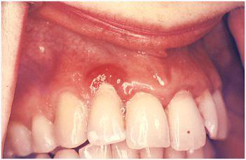
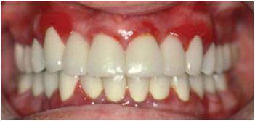
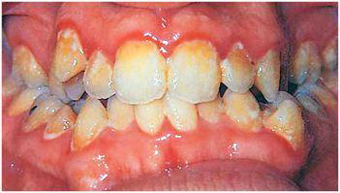
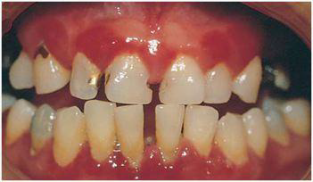

Slide 13
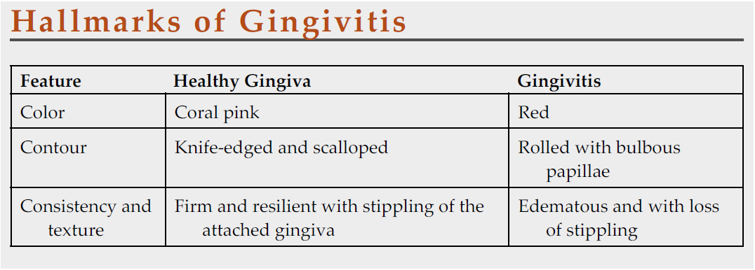
Very very important…….

Slide 14
Gingival Bleeding on Probing
Significance
Etiology
Histopathology
Method to check
Bleeding indices

Slide 16
Gingival Bleeding on Probing
Significance:
One of the earliest signs of gingival inflammation
Bleeding is a more objective sign that requires less subjective estimation by the examiner.
Smoking was found to exert a strong, chronic, dose-dependent suppressive effect on gingival bleeding on probing.

Slide 17
ETIOLOGY
LOCAL FACTORS
SYSTEMIC FACTORS
CONTRIBUTING FACTORS
Chronic and Recurrent Bleeding
Acute Bleeding
Vascular abnormality:
Vit. C . Deficiency
Allergy (Schonlein –Henoch Purpura)
Vitamin K deficiency (hypoprothombinemia)
Platelet disorder
idiopathic thrombocytopenic purpura

Slide 18
SYSTEMIC FACTORS
Coagulation defects
Haemophillia
Christmas disease
Malignancy : leukemia
Drugs :
Salicylates, anticoagulants, anticonvulsant, antihypertensive…

Slide 19
CONTRIBUTING FACTORS to plaque retention that may lead to gingivitis include.........
anatomic and developmental tooth variations,
caries,
frenum pull,
iatrogenic factors,
malpositioned teeth, mouth breathing,
overhangs,
partial dentures,
lack of attached gingiva, and recession
Orthodontic treatment & fixed retainers

Slide 20
Chronic and Recurrent Bleeding
most common ..........chronic inflammation.
provoked by mechanical trauma (e.g., from toothbrushing, toothpicks, or food impaction) or by biting into solid foods such as apples.

Slide 21
Histopathology
include dilation and engorgement of the capillaries and
thinning or ulceration of the sulcular epithelium.
Because the capillaries are engorged and closer to the surface, and the thinned, degenerated epithelium is less protective, stimuli that are normally innocuous cause rupture of the capillaries and gingival bleeding.

Slide 22
Sites that bleed on probing have a greater area of inflamed connective tissue (i.e., cell-rich, collagen-poor tissue) than sites that do not bleed.
predominantly lymphocytic (a characteristic of stage II, or early, gingivitis)

Slide 23
After the vessels are damaged and ruptured,
HEMOSTASIS
vessel walls contract
blood flow is diminished
blood platelets adhere to the edges of the tissue; and
a fibrous clot is formed,
which contracts and results in approximation of the edges of the injured area.
Bleeding recurs when the area is irritated

Slide 24
Acute bleeding.....
caused by injury
can occur spontaneously in gingival disease.
Laceration of the gingiva
by toothbrush bristles
by sharp pieces of hard food
Gingival burns from hot foods or chemicals
Spontaneous bleeding or bleeding on slight provocation can occur in Acute Necrotizing Ulcerative Gingivitis

Slide 25
METHOD TO CHECK BLEEDING ON PROBING
Instrument used ?
Pressure applied ?
Method of probing ?
Waiting time ?

Slide 26
Gingival Bleeding Indices
Write any 5 Gingival Bleeding Indices

Slide 27
summary
Gingivitis can be classified based on duration as acute, chronic, and recurrent gingivitis.Based on the involvement of teeth it can be classified as localized and generalized gingivitis.
Based on the location gingivitis can be classified as marginal, attached and papillary gingivitis. Gingival disease in individual cases can be described by combining location, and involved teeth.

Slide 28
Reference
Newman MG, Takei HH, Klokkevold PR, Carranza FA. Carranza’s clinical periodontology, 10th ed. Saunders Elsevier; 2007.
Lindhe J, Lang NP and Karring T. Clinical Periodontology and Implant Dentistry. 6th ed. Oxford (UK): Blackwell Publishing Ltd.; 2015.
Newman MG, Takei HH, Klokkevold PR, Carranza FA. Carranza’s clinical periodontology, 13th ed. Saunders Elsevier; 2018.

Slide 29
THANK YOU

